Slide 1

Sentiment Analysis Project
Identify the Effectiveness of a Drug
By Hannes Schiller

Slide 2
Problem Statement
Problem Statement
Build a ML system for processing user reviews on drugs to provide an overview of the effectiveness or adverse reactions of the drug. Identify the drugs that could be repurposed.
This process will allow companies to automatically review millions of people’s reviews to different drugs.
Objective:
Given textual data on a Drug, build a ML model to determine its effectiveness.
Input Text Data | Output Classification
“Best treatment for Hair loss” | Effective
“drug didn’t work at all! What a waste of time” | Ineffective
“Terrible side effect! I was in so much pain!” | Adverse
Notes:
Rephrase the problem statement
Better treatment
Take in blah and out blah

Slide 3
Dataset Overview
Dataset Overview
Total Observation: 215,063
Variables: 6
Train Dataset: 153,617
Test Dataset: 61,446
Train(80%) Test(20%) Split
Name | Feature | Meaning
DrugName | categorical | name of drug
Condition | categorical | name of condition
Review | text | patient review
Rating | numerical | 10 star satisfaction rating
Date | date | date of review entry
Useful Count | numerical | number of users who found
Notes:
Explain 80 20

Slide 4
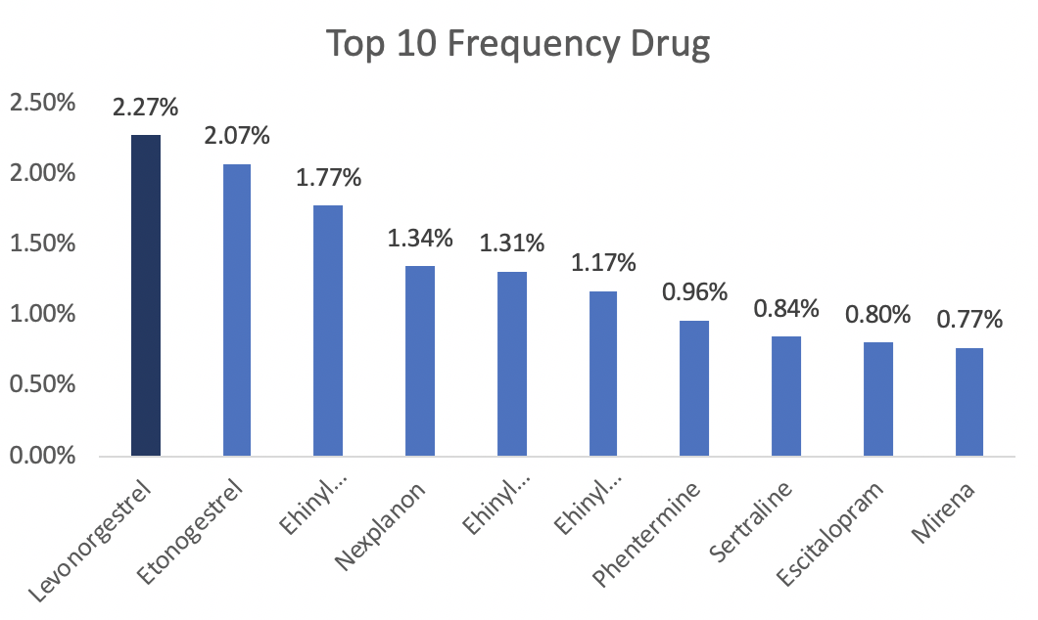
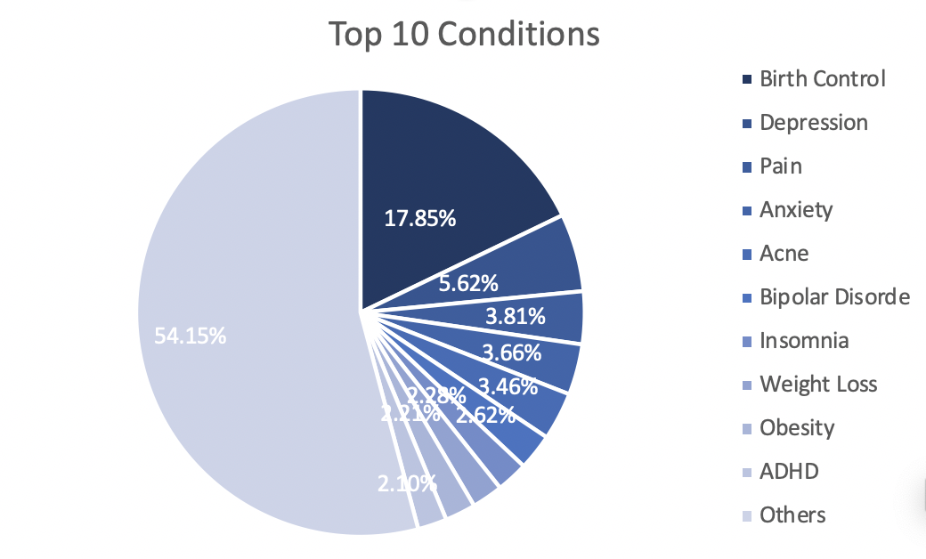
Dataset Overview
Dataset Overview
3,436 different drugs with scattered distribution
Birth Control represent 17.85% of conditions

Slide 5
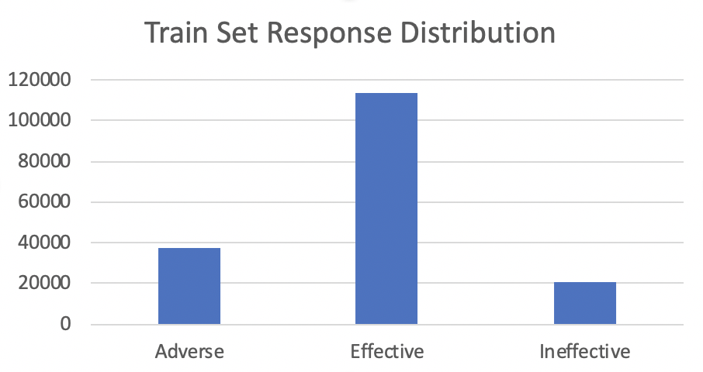
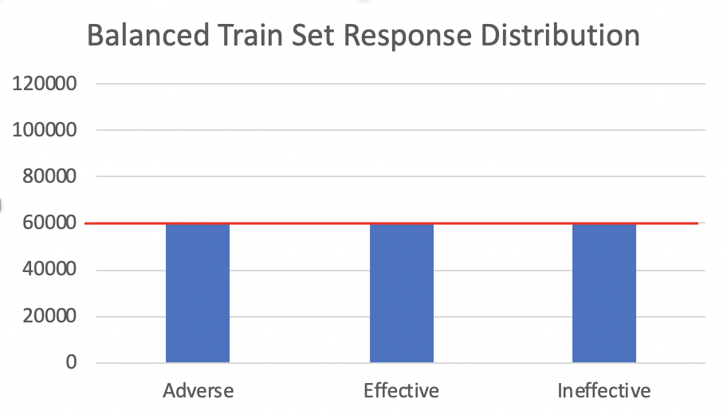

Data Overview
Response Variable: rating (score: 1 - 10)
Rating: Adverse 0-3, Ineffective 4-6, Effective 7-10
Imbalanced data: classification output biased on the majority class
Over-sampling and under-sampling: 60,000 observations in each category
Imbalanced
classification
Balanced
classification
Notes:
Nicer format about the three categray, shorter time

Slide 6
Data Preprocessing
Lower case
Remove Punctuation
Remove Stop words like “The”, “Is” and “and”
Stem Words like “Playing”, “Played”, and “Plays” changed to “Play”
Vectorizing the Text
Removing Sparse Words, which means remove words that show up more than 95% of the instances.

Slide 7
Preprocessing Example
Deloitte's the best company to work for according to Fortune Magazine
Remove Punctuation and Lower Case:
deloitte the best company to work for according to fortune magazine
Remove Stop Words & Stemming:
deloitte best company work accord fortune magazine
Vectorize Text Data:
Remove Sparse Word at 95% Rate & insert to Dataset:
deloitte | best | company | work | accord | fortune | magazine
best | company | work | accord | fortune
1 | 1 | 1 | 1 | 1
Notes:
Journey of preprocessing end output

Slide 8
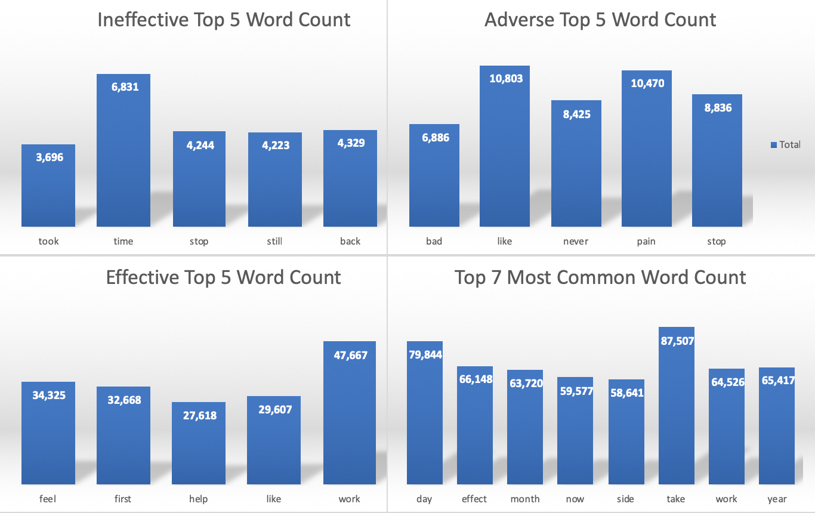
Analysis of Text
Analysis of Text

Slide 9
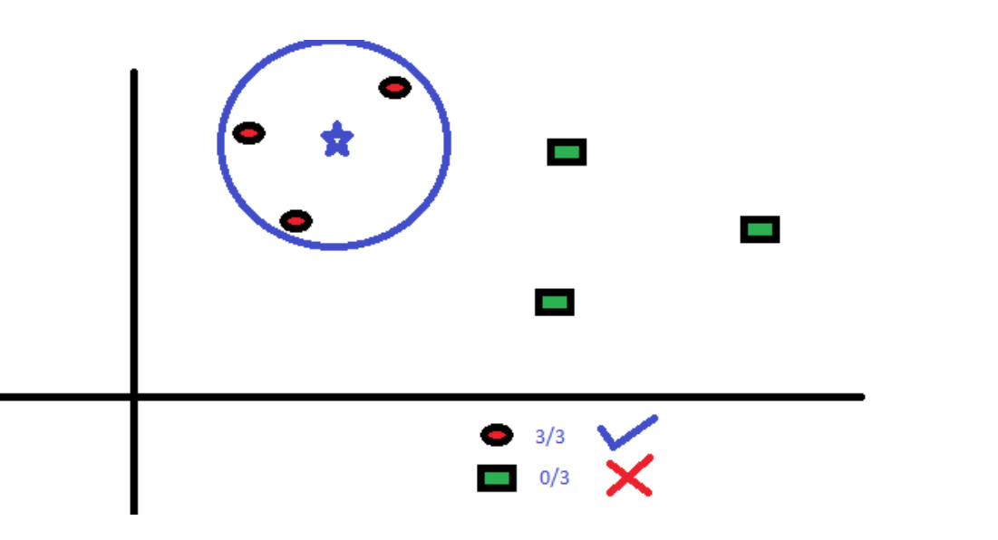
Model Building: KNN
Model Building: KNN
Using Pattern Recognition, k-nearest neighbors algorithm is a non-parametric method used for classification. The input consists of the k-closest training examples in the feature space. Depending on the classification of the k-nearest observations, it will determine the prediction of the observation.

Slide 10
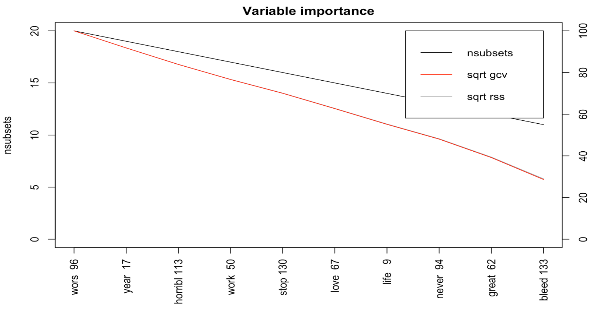
KNN Model
KNN Model Variable Importance
KNN Model Results
 | NSUBSETS | GCV | RSS
Wors | 20 | 100.0 | 100.0
Year | 19 | 91.8 | 91.8
Horribl | 18 | 83.9 | 83.9
Work | 17 | 76.6 | 76.6
Stop | 16 | 70.0 | 70.1
Love | 15 | 62.7 | 62.8
Life | 14 | 55.1 | 55.3
Never | 13 | 48.0 | 48.2
Great | 12 | 39.2 | 39.4
Bleed | 11 | 28.7 | 29.0

Slide 11
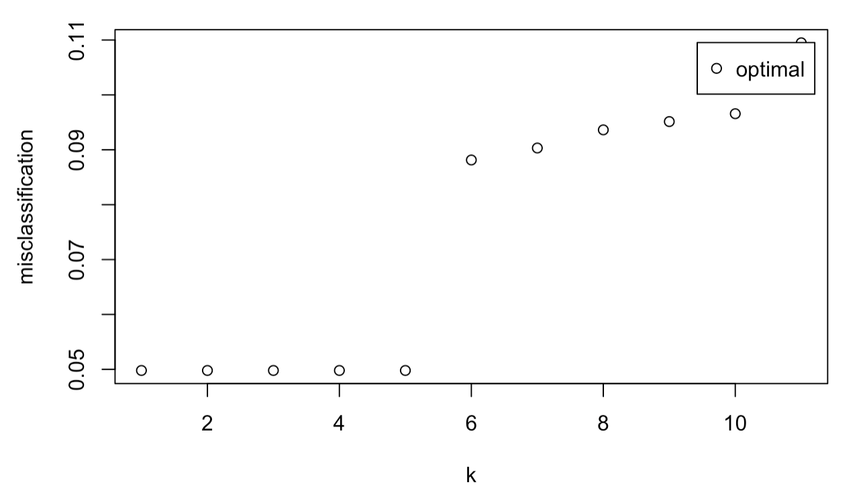
KNN Model Results
Min Misclassification: 0.04979444
Optimal Model: K=5
AUC:0.887
Accuracy: 82%

Slide 12
Conclusion
KNN Result
Confusion Matrix for KNN model
True Adverse Rate: 82.78% True Effective Rate: 85.52%
True Ineffective Rate: 71.86%
Actual | Prediction
 |  | Adverse | Effective | Ineffective
 | Adverse | 7764 | 848 | 769
 | Effective | 2020 | 23765 | 2676
 | Ineffective | 593 | 854 | 3724

Slide 13
Demonstration
Demonstration
Examples | Predict Category
 | Effective
 | Effective
 | Adverse
 | Adverse
"Best treatment for acne I have used. ”
“Love this, no mouth sores, or ulcers like Wellbutrin gave me. I COMPLETELY QUIT SMOKING… this works”.
"It made me horribly sick. I was nauseous all day, and wouldn’t eat for days at a time.”
“Awful medicine, the worst. The side effects outweigh the benefit.”

Slide 14
Thank You

